Slide 1
An Introduction to ZAP
The OWASP Zed Attack Proxy
OWASP AppSec
Europe 2011
Simon Bennetts
        Sage UK Ltd
        OWASP ZAP Project Lead
  psiinon@gmail.com

Slide 2
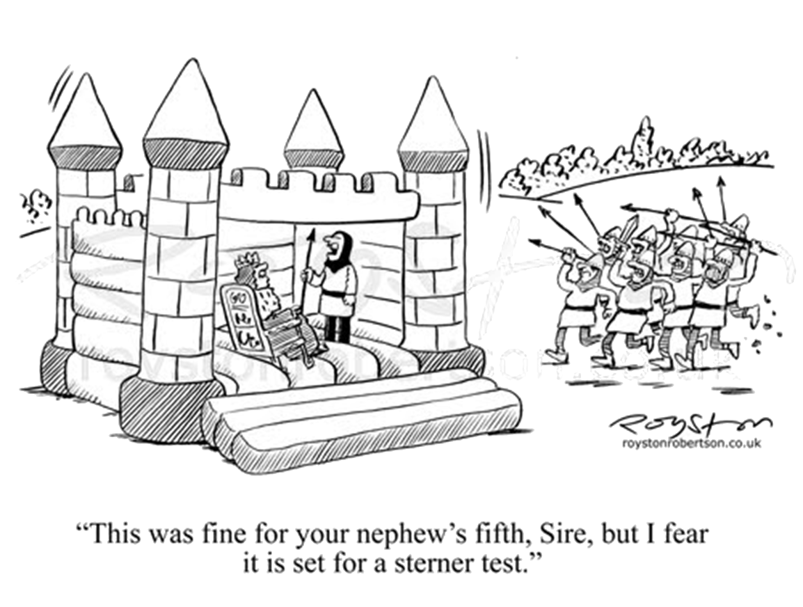
The Introduction
  The statement
    You cannot build secure
    web applications unless you
    know how to attack them
  The problem
    For many developers
    ‘penetration testing’ is a black art
  The solution
    Teach basic pentesting techniques to developers
Thanks to Royston Robertson www.roystonrobertson.co.uk for permission to use his cartoon!

Slide 3
The Caveat
This is in addition to:
  Teaching secure coding techniques
  Teaching about common vulnerabilities
  (e.g. OWASP top 10)
  Secure Development Software Lifecycle
  Static source code analysis
  Code reviews
  Professional pentesting
  …

Slide 4

The Zed Attack Proxy
Released September 2010
Ease of use a priority
Comprehensive help pages
Free, Open source
Cross platform
A fork of the well regarded Paros Proxy
Involvement actively encouraged
Adopted by OWASP October 2010

Slide 5

9 months later…
Version 1.2.0 downloaded > 6300 times
Version 1.3.0 just released
5 main coders, 15 contributors
Fully internationalized
Translated into 9 languages:
Brazilian Portuguese, Chinese, French, German, Greek, Indonesian, Japanese, Polish, Spanish
Mostly used by Professional Pentesters?
Paros code: ~55% Zap Code: ~45%

Slide 6

ZAP Principles
Free, Open source
Cross platform
Easy to use
Easy to install
Internationalized
Fully documented
Involvement actively
encouraged
Reuse well regarded components

Slide 7
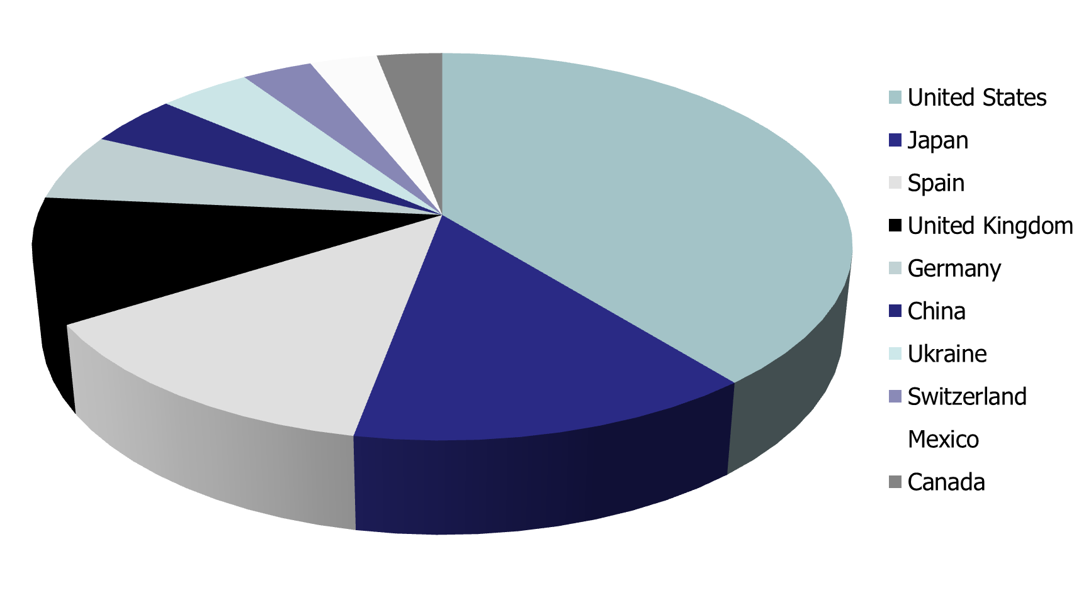
Where is ZAP being used?

Slide 8

The Main Features
All the essentials for web application testing
Intercepting Proxy
Active and Passive Scanners
Spider
Report Generation
Brute Force (using OWASP DirBuster code)
Fuzzing (using OWASP JBroFuzz code)

Slide 9

The Additional Features
  Auto tagging
  Port scanner
  Smart card support
  Session comparison
  Invoke external apps
  BeanShell integration
  API + Headless mode
  Dynamic SSL Certificates
  Anti CSRF token handling

Slide 10
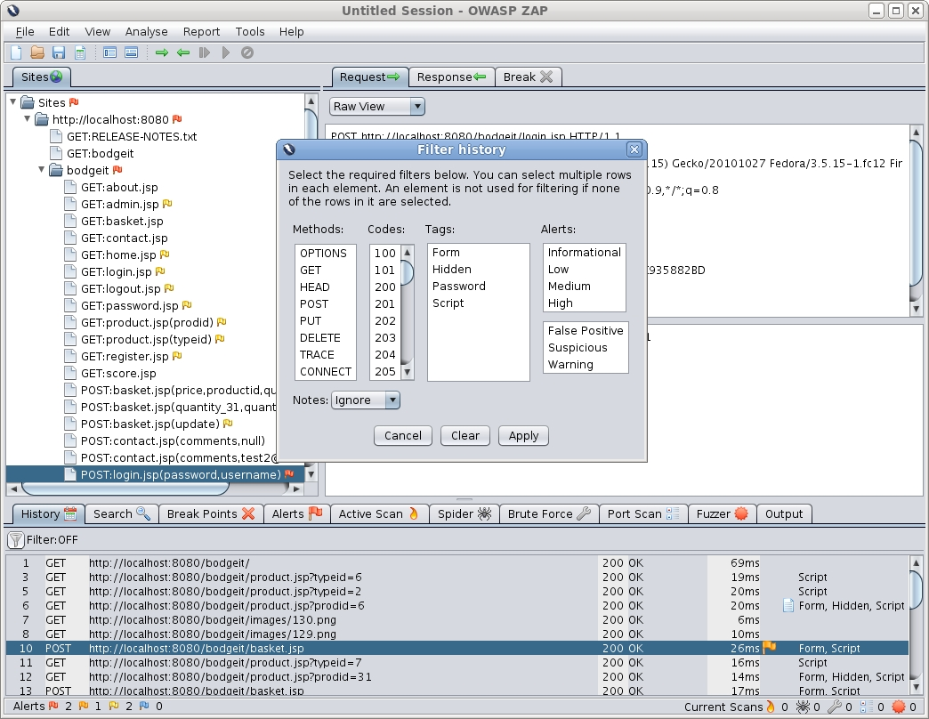
The Demo

Slide 11

The Future
Enhance scanners to detect more vulnerabilities
Extend API, better integration
Fuzzing analysis
Easier to use, better help
More localization
(all offers gratefully received!)
Parameter analysis?
Technology detection?
What do you want?? ☺

Slide 12
Summary and Conclusion 1
ZAP is:
  Easy to use (for a web app pentest tool;)
  Ideal for appsec newcomers
  Ideal for training courses
  Being used by Professional Pen Testers
  Easy to contribute to (and please do!)
  Improving rapidly

Slide 13
Summary and Conclusion 2
ZAP has:
  An active development community
  An international user base
  The potential to reach people new to OWASP and appsec, especially developers and functional testers
ZAP is a key OWASP project

Slide 14
Any Questions? http://www.owasp.org/index.php/OWASP_Zed_Attack_Proxy_Project

